Slide 1
Applied Mechanism Design For Social Good
John P Dickerson
Lecture #20 – 04/9/2021
Lecture #21 – 04/14/2021
CMSC828M
Tuesdays & Thursdays
2:00pm – 3:15pm

Slide 2
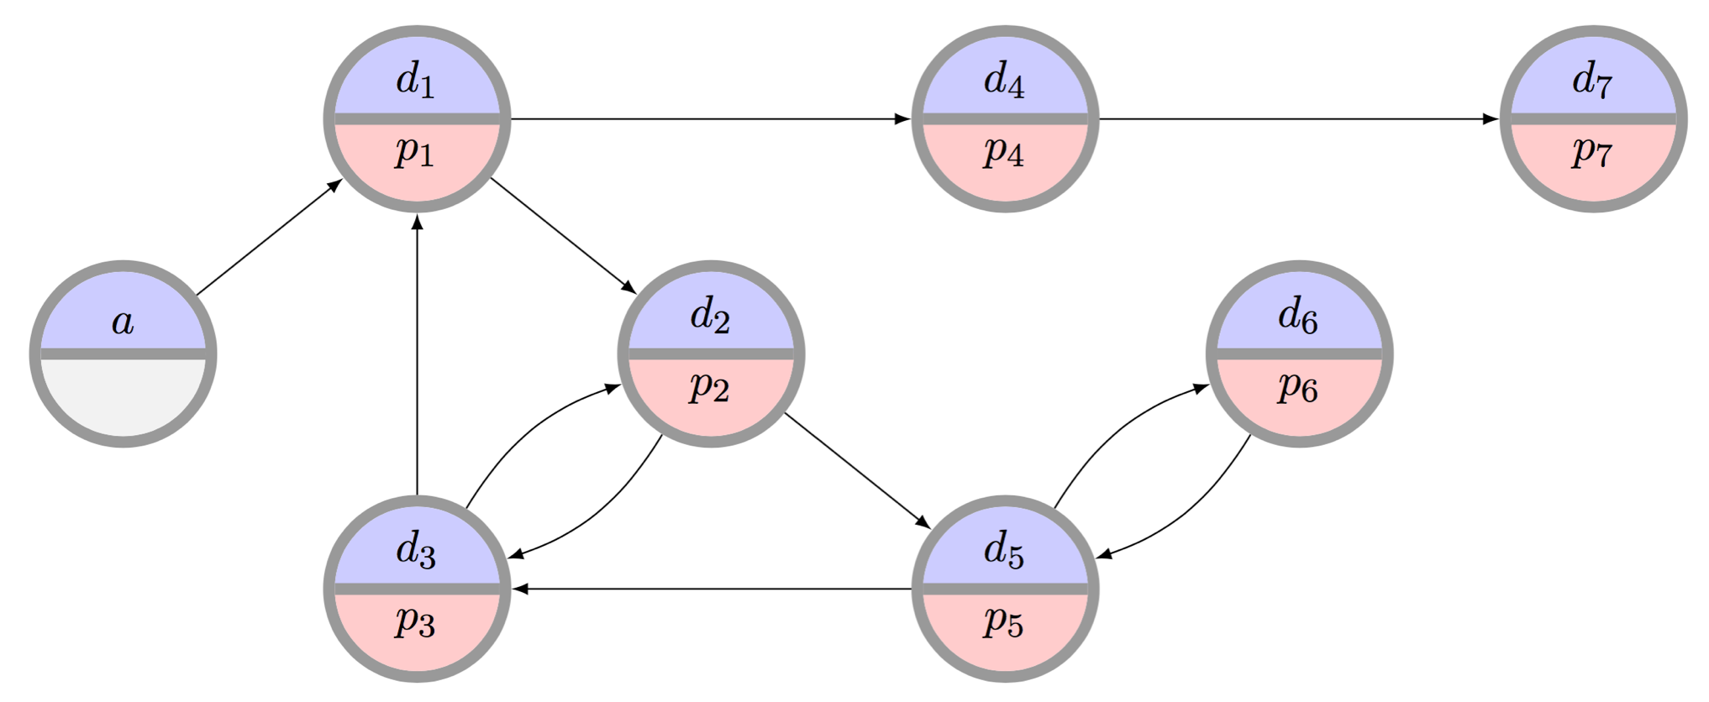
The clearing problem
The clearing problem is to find the “best” disjoint set of cycles of length at most L, and chains
Typically, 2 ≤ L ≤ 5 for kidneys (e.g., L=3 at UNOS)
NP-hard (for L>2) in theory, really hard in practice
[Glorie et al. 2014,
Anderson et al. 2015,
Plaut et al. 2016,
Dickerson et al. 2016 ...]
[Abraham et al. 07, Biro et al. 09]

Slide 3
Special case: L = 2
PTIME: translate to maximum matching on undirected graph
v₁
v₂
v₃
v₄
v₁
v₂
v₃
v₄
v₆
v₅
v₆
v₅
???????????????
(Six pairs, no altruists.)
v₁
v₂
v₃
v₄
v₁
v₂
v₃
v₄
v₆
v₅
v₆
v₅

Slide 4
Special case: L = ∞
PTIME via formulation as maximum weight perfect matching
v₁
v₂
v₃
v₄
v₁
v₂
v₃
v₄
v₆
v₅
v₆
v₅
???????????????
(Six pairs, no altruists.)
Donors:
d₁
d₂
d₃
d₄
d₅
d₆
Edge weights:
= 0
= w_{e}
Patients:
p₁
p₂
p₃
p₄
p₅
p₆

Slide 5
General Case: L = ?
NP-hard via reduction from 3D-matching:
Given disjoint sets X, Y, Z of size q …
... and a set of triples T ⊆ X x Y x Z ...
... is there a disjoint subset M ⊆ T of size q?
1
1
1
T = {
(1,1,1),
(2,3,2),
(1,2,1),
(3,2,3),
}
2
2
2
3
3
3
??????????????

Slide 6
General Case: L = ?
Construct a gadget for each t_{i} = {x_{a}, y_{b}, z_{c}} in T
Gadgets intersect only on vertices in X ⋃ Y ⋃ Z
x_{a}^{i}
y_{b}^{i}
z_{c}^{i}
1
2
L-1
1
2
L-1
1
2
L-1
x_{a}
y_{b}
z_{c}

Slide 7
General case: L = ?
M is perfect matching → construction has perfect cycle cover.
For t_{i} in T:
x_{a}^{i}
y_{b}^{i}
z_{c}^{i}
1
2
L-1
1
2
L-1
1
2
L-1
x_{a}
y_{b}
z_{c}

Slide 8
General case: L = ?
M is perfect matching → construction has perfect cycle cover.
For t_{i} not in T:
x_{a}^{i}
y_{b}^{i}
z_{c}^{i}
1
2
L-1
1
2
L-1
1
2
L-1
x_{a}
y_{b}
z_{c}

Slide 9
General Case: L = ?
We have a perfect cycle cover → M is a perfect 3D matching
Construction only has 3-cycles and L-cycles
Short cycles (i.e., 3-cycles) are disjoint from the rest of the graph by construction
Thus, given a perfect cover (by assumption):
Widgets either contribute according to t_{i} in M …
… or t_{i} not in M.
Thus there is a perfect matching in the original 3D matching instance.

Slide 10
Hopeless …?

Slide 11
A Simple Integer program
(“Best” = max weight, myopic matching)
[Roth et al. 04, 05, Abraham et al. 07]
Binary variable x_{c} for each feasible cycle or chain c
Maximize
u(M) = Σ w_{c} x_{c}
Subject to
Σ_{c : i in c} x_{c} ≤ 1 for each vertex i
“Simple” …?

Slide 12
Basic Approach #1: The Edge formulation
[Abraham et al. 2007]
Binary variable x_{ij} for each edge from i to j
Maximize
u(M) = Σ w_{ij} x_{ij}
Subject to
Σ_{j} x_{ij} = Σ_{j} x_{ji} for each vertex i
Σ_{j} x_{ij} ≤ 1 for each vertex i
Σ_{1≤k≤L} x_{i(k)i(k+1)} ≤ L-1 for paths i(1)…i(L+1)
(no path of length L that doesn’t end where it started – cycle cap)
Flow constraint

Slide 13
State of the art for edge formulation
[Anderson et al. PNAS-2015]
Builds on the prize-collecting traveling salesperson problem [Balas Networks-89]
PC-TSP: visit each city (patient-donor pair) exactly once, but with the additional option to pay some penalty to skip a city (penalized for leaving pairs unmatched)
They maintain decision variables for all cycles of length at most L, but build chains in the final solution from decision variables associated with individual edges
Then, an exponential number of constraints could be required to prevent the solver from including chains of length greater than K; these are generated incrementally until optimality is proved.
Leverage cut generation from PC-TSP literature to provide stronger (i.e. tighter) IP formulation

Slide 14
Best Edge Formulation
[Anderson et al. 2015]
A
Ck
C3
If: flow into v from a chain
Then: at least as much flow across cuts from {A}
A
C1
V
A
C2
…
Notes:
If there is flow into V, then for every way V can be cut off from NDDs, there must be at least as much flow over that cut.

Slide 15
Basic Approach #2: The Cycle Formulation
[Roth et al. 2004, 2005,
Abraham et al. 2007]
Binary variable x_{c} for each feasible cycle or chain c
Maximize
u(M) = Σ w_{c} x_{c}
Subject to
Σ_{c : i in c} x_{c} ≤ 1 for each vertex i

Slide 16
Solving the Cycle Formulation IP
Too large to write down
O(max{ |P|^{L}, |A||P|^{K-1} }) variables
|A| = 5, |V|=300, L=3, K=20 … |A||P|^{K-1} ≈ 5 x 10⁴⁷
Approach: branch-and-price [Barnhart et al. 1998]:
Branch: select fractional column and fix its value to 1 and 0 respectively
Fathom the search node if no better than incumbent
Solve LP relaxation using column generation
x₇
1
0
x₄
…
1
0
…
…
Notes:
Even with only 1000 patients, there are 3M cycles.

Slide 17
Column generation
Master LP P has too many variables
Won’t fit in memory, and/or would take too long to solve
Begin with restricted LP P’, which contains only a small subset of the variables (i.e., cycles)
OPT(P’) ≤ OPT(P)
Solve P’ and, if necessary, add more variables to it
We do this intelligently by solving the pricing problem
Repeat until OPT(P’) = OPT(P)

Slide 18
DFS to solve pricing problem
[Abraham et al. EC-07]
Pricing problem:
Optimal dual solution π* to reduced model
Find non-basic variables with positive price (for a maximization problem)
0 < weight of cycle – sum of duals in π* of constituent vertices
Positive price for cycle → dual constraint is violated
No positive price cycles → no dual constraints violated
First approach [Abraham et al. EC-2007] explicitly prices all feasible cycles and chains through a DFS
Can speed this up in various ways, but proving no positive price cycles exist still takes a long time

Slide 19
General pricing of cycles & Chains is NP-hard
[Plaut et al. arXiv:1606.00117]
Reduce from Hamiltonian path
Arbitrary graph G

Slide 20
Comparison
Tradeoffs in number of variables, constraints
IP #1: O(|E|^{L}) constraints vs. O(|V|) for IP #2
IP #1: O(|V|²) variables vs. O(|V|^{L}) for IP #2
IP #2’s relaxation is weakly tighter than #1’s. Quick intuition in one direction:
Take a length L+1 cycle. #2’s LP relaxation is 0.
#1’s LP relaxation is (L+1)/2 – with ½ on each edge
Recent work focuses on balancing tight LP relaxations and model size [Constantino et al. 2013, Glorie et al. 2014, Klimentova et al. 2014, Alvelos et al. 2015, Anderson et al. 2015, Mak-Hau 2015, Manlove&O’Malley 2015, Plaut et al. 2016, …]:
Newest work: compact formulations, some with tightest relaxations known, all amenable to failure-aware matching

Slide 21
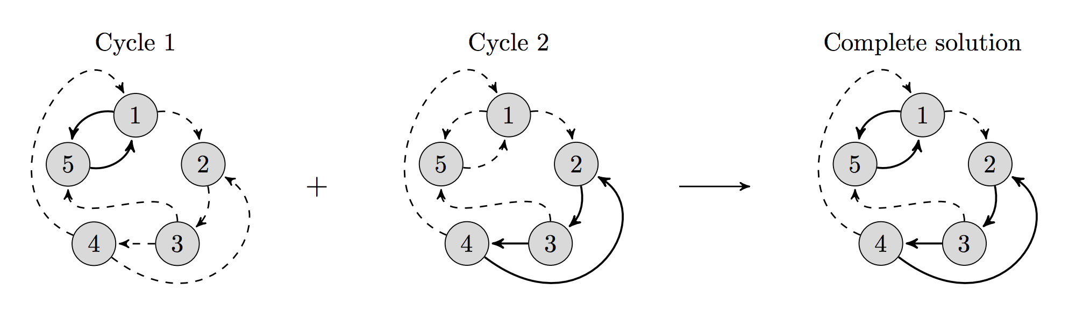
Compact formulations
[Constantino et al. EJOR-14]
Previous models: exponential #constraints (CG methods) or #variables (B&P methods)
Let F be upper bound on #cycles in a final matching
Create F copies of compatibility graph
Search for a single cycle or chain in each copy
(Keep cycles/chains disjoint across graphs)

Slide 22
Compact formulations
1A
1B
1C
1D
1E
1A: max edge weights over all graph copies
1B: give a kidney <-> get a kidney within that copy
1C: only use a vertex once
1D: cycle cap
Polynomial #constraints and #variables!

Slide 23
PIEF: A compact model for cycles only
[Dickerson Manlove Plaut Sandholm Trimble EC-16]
Builds on Extended Edge Formulation of Constantino et al.
O(|V|) copies of graph, 1 binary variable per edge per copy
Enforce at most one cycle per graph copy used
Track positions of edges in cycles for LP tightness
THEOREM
The tightest known non-compact LP relaxation Z_{CF} = Z_{PIEF} (disallowing chains)
(EC-16 paper also presents HPIEF, which is a compact formulation for cycles and chains, but with weaker Z_{HPIEF})

Slide 24
PICEF: Position-Indexed Chain-Edge Formulation
In practice, cycle cap L is small and chain cap K is large
Idea: enumerate all cycles but not all chains [Anderson et al. 2015]
That work required O(|V|^{K}) constraints in the worst case
This work requires O(K|V|) = O(|V|²) constraints
MAIN
IDEA
Track not just if an edge is used in a chain, but where in a chain an edge is used.
For edge (i,j) in graph: K’(i,j) = {1} if i is an altruist
K’(i,j) = {2, …, K} if i is a pair

Slide 25
PICEF: Position-Indexed Chain-Edge Formulation
Maximize
u(M) = Σ_{ij in E} Σ_{k in K’(i,j)} w_{ij} y_{ijk} + Σ_{c in C} w_{c} z_{c}
Subject to
Σ_{ij in E} Σ_{k in K’(i,j)} y_{ijk} + Σ_{c : i in c} z_{c} ≤ 1 |  | for every i in Pairs
Each pair can be in at most one chain or cycle
Σ_{ij in E} y_{ij1} ≤ 1 |  | for every i in Altruists
Each altruist can trigger at most one chain via outgoing edge at position 1
Σ_{j:ij in E} y_{ijk+1} - Σ_{j:ji in E ⌃ k in K’(j,i)} y_{jik} ≤ 0 |  | for every i in Pairs and k in {1, …, K-1}
Each pair can be have an outgoing edge at position k+1 in a chain iff it has an incoming edge at position k in a chain

Slide 26
What if there are Still too many Variables?
In particularly dense graphs or if, in the future, longer cycle caps are allowed, PICEF may need too many cycle variables
Solve via branch and price by storing only a subset of columns in memory, then solving pricing problem
Search for variables with positive price, bring into model
Previously: that search is exponential in chain cap [Abraham et al. 2007, Glorie et al. 2014, Plaut et al. 2016]
General: pricing chains & cycle is NP-hard [arXiv:1606.00117]
But we only need to price cycles, not chains!
PRICING
PICEF is the first branch-and-price-based model with provably correct polynomial-time pricing

Slide 27
Polynomial-TIME Cycle Pricing
[Glorie et al. MSOM-2014, Plaut et al. AAAI-2016]
Solve a structured problem that implicitly prices variables
Variable = x_{c} for cycle (not chain) c
Price of x_{c} = w_{c} – Σ_{v in c} δ_{v}
Example
Price: (2+3+2) – (δ_{P1}+δ_{P2}+δ_{P3})
= Σ_{e in c} w_{e} – Σ_{v in c} δ_{v} = Σ_{(u,v) in c} [w_{(u,v)} – δ_{v}]
Idea: Take G, create G’ s.t. all edges e = (u,v) are reweighted r_{(u,v)} = δ_{v} – w_{(u,v)}
Positive price cycles in G = negative weight cycles in G’
P1
2
2
P2
3
P3
w_{c}

Slide 28
Adapted Bellman-Ford Pricing for cycles only
[Glorie et al. MSOM-2014, Plaut et al. AAAI-2016]
Bellman-Ford finds shortest paths
Undefined in graphs with negative weight
Adapt B-F to prevent internal looping during the traversal
Shortest path is NP-hard (reduce from Hamiltonian path):
Set edge weights to -1, given edge (u,v) in E, ask if shortest path from u to v is weight 1-|V| → visits each vertex exactly once
We only need some short path (or proof that no negative cycle exists)
Now pricing runs in time O(|V||E|L²)

Slide 29
How do All These models perform in PRactice?
Test on real and simulated match runs from:
US UNOS exchange: 143+ transplant centers
UK NLDKSS: 20 transplant centers
Following are tests against actual code for:
BnP-DFS [Abraham et al. EC-07]
BnP-Poly [Glorie et al. MSOM-14, Plaut et al. AAAI-16]
CG-TSP [Anderson et al. PNAS-15]

Slide 30
Real Match Runs UNOS & NLDKSS

Slide 31
UNOS: 286 match runs
NLDKSS: 17 match runs

Slide 32
Generated Data |P|=700, Increasing %Altruists

Slide 33
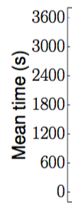
Solvers that are not shown timed out (within one-hour period).
Notes:
CG-TSP, BP-DFS, and others timed out, while our models * Can still clear these exchange
* Scale more gracefully

Slide 34
The Big Problem
What is “best”?
Maximize matches right now or over time?
Maximize transplants or matches?
Prioritization schemes (i.e. fairness)?
Modeling choices?
Incentives? Ethics? Legality?
Optimization can handle this, but may be inflexible in hard-to-understand ways (for humans)
Want humans in the loop at a high level (and then CS/Opt handles the implementation)

Slide 35
Managing short-term uncertainty
[EC-13, EC-15, EC-16, Management Science to appear]
With A. Blum, N. Haghtalab, D. Manlove, B. Plaut, A. Procaccia, T. Sandholm, A. Sharma, J. Trimble

Slide 36
Matched ≠ Transplanted
Only around 10-15% of UNOS matched structures result in an actual transplant
Similarly low % in other exchanges [ATC 2013]
Many reasons for this. How to handle?
One way: encode probability of transplantation rather than just feasibility
for individuals, cycles, chains, and full matchings

Slide 37
Failure-aware model
Compatibility graph G
Edge (v_{i}, v_{j}) if v_{i}’s donor can donate to v_{j}’s patient
Weight w_{e} on each edge e
Success probability q_{e} for each edge e
Discounted utility of cycle c
u(c) = ∑w_{e} • ∏q_{e}
Value of successful cycle
Probability of success

Slide 38


Failure-aware model
Discounted utility of a k-chain c
Cannot simply “reweight by failure probability”
A
q₁
1
q₂
2
q₃
3
q₄
4
… + 2q₁q₂(1-q₃)
1q₁(1-q₂)
… + 4q₁q₂q₃q₄
… + 3q₁q₂q₃(1-q₄)
Exactly first i transplants
Chain executes in entirety

Slide 39
Discounted clearing problem
(“Best” = max expected cardinality | limited recourse)
Find matching M* with highest discounted utility
3
Maximum cardinality
Maximum expected transplants
0.1
0.1
0.9
1
2
0.9

Slide 40
Solving this new problem
Theorem: In a sparse random graph model, for any failure probability p, w.h.p. there exists a matching that is “linearly better” than any max-cardinality matching
Practice: Solved via branch-and-price
One binary decision variable per cycle/chain
Upper-bounding is now NP-hard
Pricing problem is (empirically) much easier
Maybe this is a good idea …

Slide 41
Considering only “good” chains
Theorem:
Given a chain c, any extension c’ will not be needed in an optimal solution if the infinite extension has non-positive value
Optimistic future value of infinite extension
Donation to waitlist
Discounted utility of current chain
Pessimistic sum of LP dual values in model

Slide 42
UNOS
2010-2014
Oct. 2010
Late 2014
Under discussion for implementation at UNOS

Slide 43
Pre-match edge testing
Idea: perform a small amount of costly testing before a match run to test for (non)existence of edges
E.g., more extensive medical testing, donor interviews, surgeon interviews, …
Cast as a stochastic matching problem:
Given a graph G(V,E), choose subset of edges S such that:
|M(S)| ≥ (1-ε) |M(E)|
Need: “sparse” S, where every vertex has O(1) incident tested edges

Slide 44
General theoretical results
Adaptive: select one edge per vertex per round, test, repeat
Stochastic matching: (1-ε) approximation with O_{ε}(1) queries per vertex, in O_{ε}(1) rounds
Stochastic k-set packing:
(2/k – ε) approximation with O_{ε}(1) queries per vertex, in O_{ε}(1) rounds
THEOREM
Non-adaptive: select O(1) edges per vertex, test all at once
Stochastic matching:
(0.5-ε) approximation with O_{ε}(1) queries per vertex, in 1 round
Stochastic k-set packing:
(2/k – ε)² approximation with O_{ε}(1) queries per vertex, in 1 round
THEOREM

Slide 45
Adaptive algorithm
For R rounds, do:
Pick a max-cardinality matching M in graph G, minus already-queried edges that do not exist
Query all edges in M
Input Graph
r | Base graph | Matching picked | Result of queries
1:
2:

Slide 46
Intuition for adaptive algorithm
If at any round r, the best solution on edges queried so far is small relative to omniscient …
... then current structrure admits large number of unqueried, disjoint augmenting structures
For k=2, aka normal matching, simply augmenting paths
Augmenting structures might not exist, but can query in parallel in a single round
Structures are constant size → exist with constant probability
Structures are disjoint → queries are independent
→ Close a constant gap per round

Slide 47
UNOS Data
At p=0.5, one edge test per vertex → +21% OPT
Even 1 or 2 extra tests would result in a huge lift

Slide 48
In theory and practice, we’re helping the global bottom line by considering post-match failure …
… But can this hurt some individuals?

Slide 49
Balancing equity and efficiency
[AAMAS-14, AAAI-15, AAAI-18, Invited to AIJ, u.r. 2018]
With D. McElfresh, A. Procaccia and T. Sandholm

Slide 50
Sensitization at UNOS
Highly-sensitized patients: unlikely to be compatible with a random donor
Deceased donor waitlist: 17%
Kidney exchanges: much higher (60%+)
“Easy to match” patients
“Hard to match” patients

Slide 51
Price of fairness
Efficiency vs. fairness:
Utilitarian objectives may favor certain classes at the expense of marginalizing others
Fair objectives may sacrifice efficiency in the name of egalitarianism
Price of fairness: relative system efficiency loss under a fair allocation
[Bertismas, Farias, Trichakis 2011]
[Caragiannis et al. 2009]

Slide 52
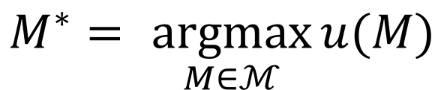
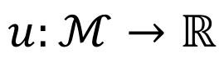
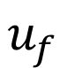
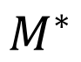
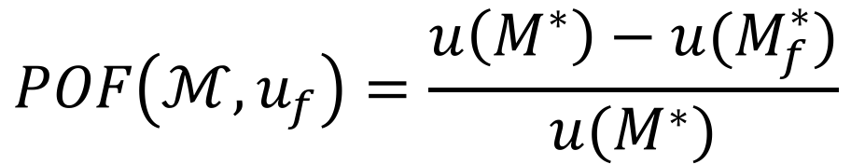
Price of fairness in kidney exchange
Want a matching that maximizes utility function
$$M^{∗}$$
$$u:ℳ→ℝ$$
$$M^{∗}= \underset{M∈ℳ}{argmax}{u(M)}$$
Price of fairness: relative loss of match efficiency due to fair utility function :
$$u_{f}$$
$$POF\left(ℳ,u_{f}\right)=\frac{u\left(M^{∗}\right)−u(M_{f}^{∗})}{u(M^{∗})}$$

Slide 53
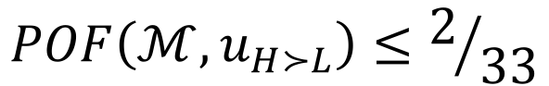
From theory to practice
We show that the price of fairness is low in theory
Fairness criterion: extremely strict.
Theoretical assumptions (standard):
Big, dense graphs (“n → ∞”)
Cycles (no chains)
No post-match failures
Simplified patient-donor features
$$POF\left(ℳ,u_{H≻L}\right)≤2/{33}$$
What about the price of fairness in practice?

Slide 54
Toward usable fairness rules
In healthcare, important to work within (or near to) the constraints of the fielded system
[Bertsimas, Farias, Trichakis 2013]
Our experience with UNOS
We now present two (simple, intuitive) rules:
Lexicographic: strict ordering over vertex types
Weighted: implementation of “priority points”

Slide 55
Lexicographic fairness
Find the best match that includes at least α fraction of highly-sensitized patients
Matching-wide constraint:
Present-day branch-and-price IP solvers rely on an “easy” way to solve the pricing problem
Lexicographic constraints → pricing problem requires an IP solve, too!
Strong guarantee on match composition …
… but harder to predict effect on economic efficiency

Slide 56
Weighted fairness
Value matching a highly-sensitized patient at (1+β) that of a lowly-sensitized patient, β>0
Re-weighting is a preprocess →
works with all present-day exchange solvers
Difficult to find a “good” β?
Empirical exploration helps strike a balance

Slide 57
UNOS MATCH RUNS
WEIGHTED FAIRNESS, VARYING FAILURE RATES

Slide 59
Contradictory goals
Earlier, we saw failure-aware matching results in tremendous gains in #expected transplants
Gain comes at a price – may further marginalize hard-to-match patients because:
Highly-sensitized patients tend to be matched in chains
Highly-sensitized patients may have higher failure rates (in APD data, not in UNOS data)

Slide 60
Beats efficient deterministic
UNOS runs, weighted fairness, constant probability of failure (x-axis), increase in expected transplants over deterministic matching (y-axis)

Slide 61
Fairness vs. efficiency can be balanced in theory and in practice in a static model …
… But how should we match over time?

Slide 62
Learning to match in a dynamic environment
[AAAI-12, AAAI-15, NIPS-15 MLHC, w.p. 2018]
With A. Procaccia and T. Sandholm

Slide 63
Dynamic kidney exchange
Kidney exchange is a naturally dynamic event
Can be described by the evolution of its graph
Additions, removals of edges and vertices
Vertex Removal | Edge Removal | Vertex/Edge Add
Transplant, this exchange | Matched, positive crossmatch | Normal entrance
Transplant, deceased donor waitlist | Matched, candidate refuses donor
Transplant, other exchange ("sniped") | Matched, donor refuses candidate
Death or illness | Pregnancy, sickness changes HLA
Altruist runs out of patience
Bridge donor reneges
How should we balance matching now versus waiting to match?

Slide 64
FutureMatch: Learning to match in dynamic environments
Offline (run once or periodically)
Domain expert describes overall goal
Take historical data and policy input to learn a weight function w for match quality
Take historical data and create a graph generator with edge weights set by w
Using this generator and a realistic exchange simulator, learn potentials for graph elements as a function of the exchange dynamics
Online (run every match)
Combine w and potentials to form new edge weights on real input graphs
Solve maximum weighted matching and return match

Slide 65
Example objective (MaxLife)
Maximize aggregate length of time donor organs last in patients …
… possibly subject to prioritization schemes, fairness, etc …
Learn survival rates from all living donations since 1987
~75,000 transplants
Translate to edge weight
Imperfect HLA match
has worse survival rate than perfect HLA match

Slide 66
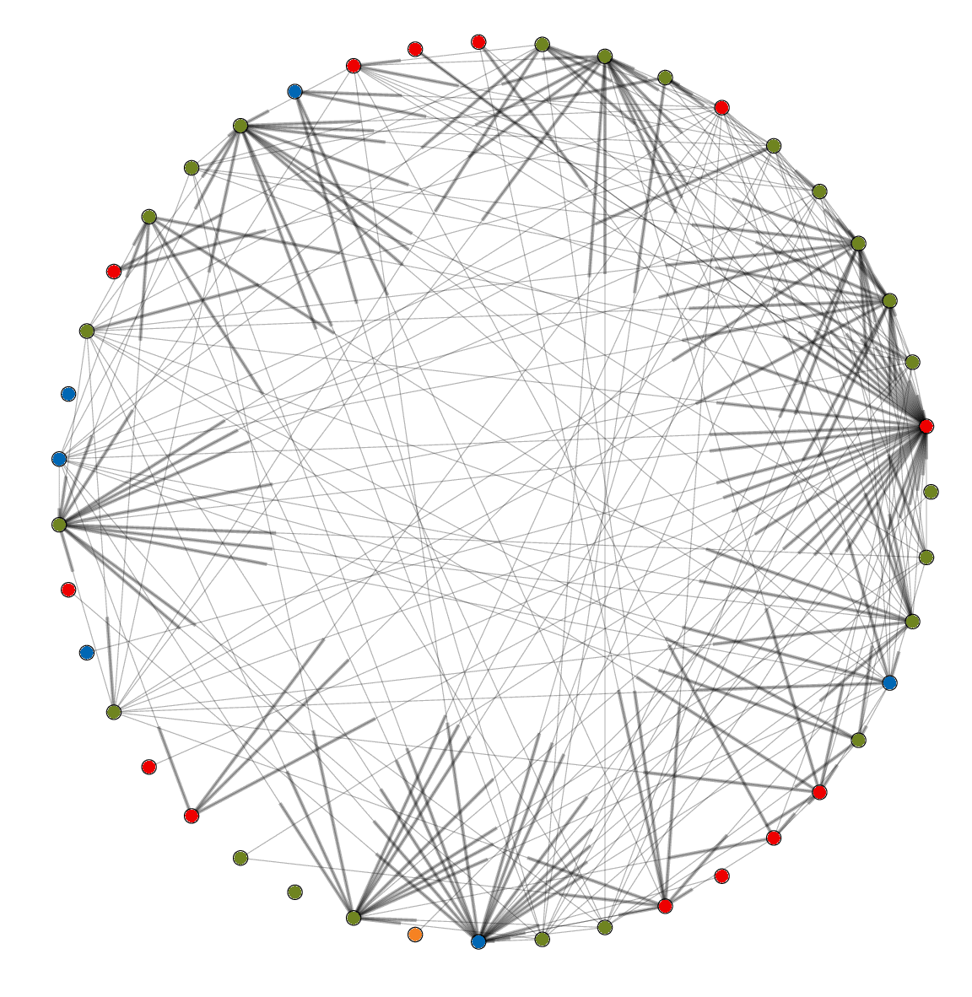
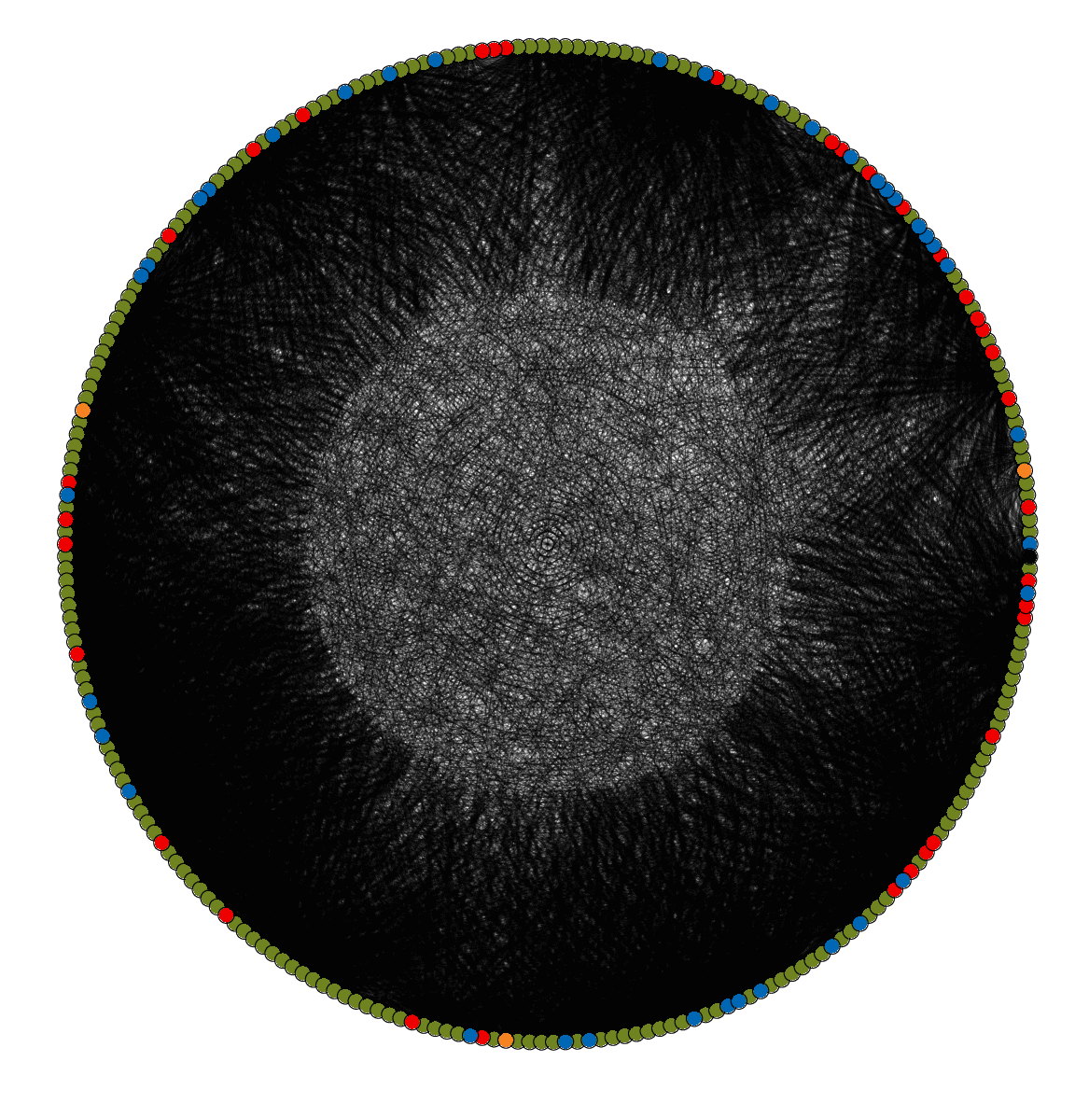
300+ match runs with real UNOS data
Important to use realistic distribution
UNOS
(first match run)
UNOS
(recent snapshot)

Slide 67
Exits
Stays
Enters

Slide 68
Full optimization problem is very difficult
Realistic theory is too complex
Trajectory-based methods do not scale
Approximation idea:
Associate with each “element type” its potential to help objective in the future
(Must learn these potentials)
Combine potentials with edge weights, perform myopic maximum utility matching

Slide 69


What is a potential?
Given a set of features Θ representing structural elements (e.g., vertex, edge, subgraph type) of a problem:
The potential P_{θ} for a type θ quantifies the future usefulness of that element
E.g., let Θ = {O-O, O-A, …, AB-AB, •-O, …, •-AB}
16 patient-donor types, 4 altruist types
O-donors better than A-donors, so: P_{•-O} > P_{•-A}
Heavy one-time computation to learn potential of each type θ – we use SMAC [Hutter Hoos Leyton-Brown 2011]

Slide 70
Online:
Adjust solver to take potentials into account at runtime
E.g., P_{•-O} = 2.1 and P_{O-AB} = 0.1
Edges between O-altruist and O-AB pair has weight: 1 – 0.5(2.1+0.1) = -0.1
Chain must be long enough to offset negative weight
Also take into account learned weight function w
Edge weight preprocess →
no or low runtime hit!

Slide 71


Experimental results & Impact
We show it is possible to:
Increase overall #transplants a lot at a (much) smaller decrease in #marginalized transplants
Increase #marginalized transplants a lot at no or very low decrease in overall #transplants
Increase both #transplants and #marginalized
Sweet spot depends on distribution:
Luckily, we can generate – and learn from – realistic families of graphs!
Presented at Supercomputing Tied with IBM Watson
FutureMatch now used for policy recommendations at UNOS

Slide 72
The Cutting Edge

Slide 73
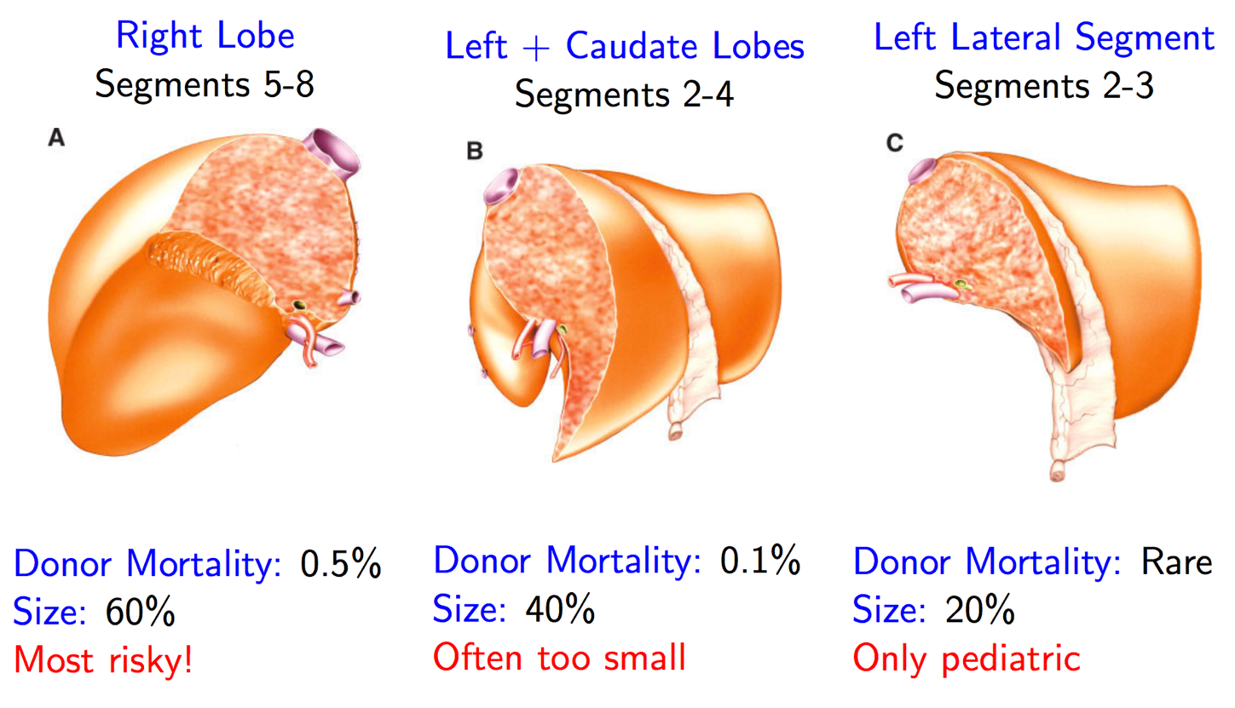
Moving beyond kidneys: Livers
[Ergin, Sönmez, Ünver w.p. 2015]
Similar matching problem (mathematically)
Right lobe is biggest but riskiest; exchange may reduce right lobe usage and increase transplants
[Sönmez 2014]

Slide 74

Moving beyond kidneys: Multi-Organ Exchange
[Dickerson Sandholm AAAI-14, JAIR-16]
Chains are great! [Anderson et al. 2015, Ashlagi et al. 2014, Rees et al. 2009]
Kidney transplants are “easy” and popular:
Many altruistic donors
Liver transplants: higher mortality, morbidity:
(Essentially) no altruistic donors
P1
P2
P3
P4
…
Kidney
A
Kidney
Liver
Kidney
D1
D2
D3
D4

Slide 75
Sparse graph, many altruists
n_{K} kidney pairs in graph D_{K}; n_{L} = γn_{K} liver pairs in graph D_{L}
Number of altruists t(n_{K})
Constant p_{K→L} > 0 of kidney donor willing to give liver
Constant cycle cap z
Theorem
Assume t(n_{K}) = βn_{K} for some constant β>0. Then, with probability 1 as n_{K} → ∞,
Any efficient matching on D = join(D_{K},D_{L}) matches Ω(n_{K}) more pairs than the aggregate of efficient matchings on D_{K} and D_{L}.
Building on [Ashlagi et al. 2012]

Slide 76
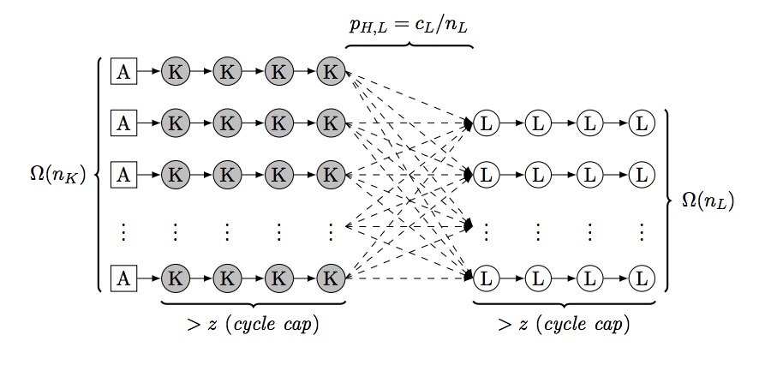
Intuition
Find a linear number of “good cycles” in D_{L} that are length > z
Good cycles = isolated path in highly-sensitized portion of pool and exactly one node in low portion
Extend chains from D_{K} into the isolated paths (aka can’t be matched otherwise) in D_{L}, of which there are linearly many
Have to worry about p_{K→L}, and compatibility between vertices
Show that a subset of the dotted edges below results in a linear-in-number-of-altruists max matching
→ linear number of D_{K} chains extended into D_{L}
→ linear number of previously unmatched D_{L} vertices matched

Slide 77
Sparse graph, few altruists
n_{K} kidney pairs in graph D_{K}; n_{L} = γn_{K} liver pairs in graph D_{L}
Number of altruists t – no longer depends on n_{K}!
λ is frac. lowly-sensitized
Constant cycle cap z
Theorem
Assume constant t. Then there exists λ’ > 0 s.t. for all λ < λ’
Any efficient matching on D = join(D_{K},D_{L}) matches Ω(n_{K}) more pairs than the aggregate of efficient matchings on D_{K} and D_{L}.
With constant positive probability.
Building on [Ashlagi et al. 2012]

Slide 78
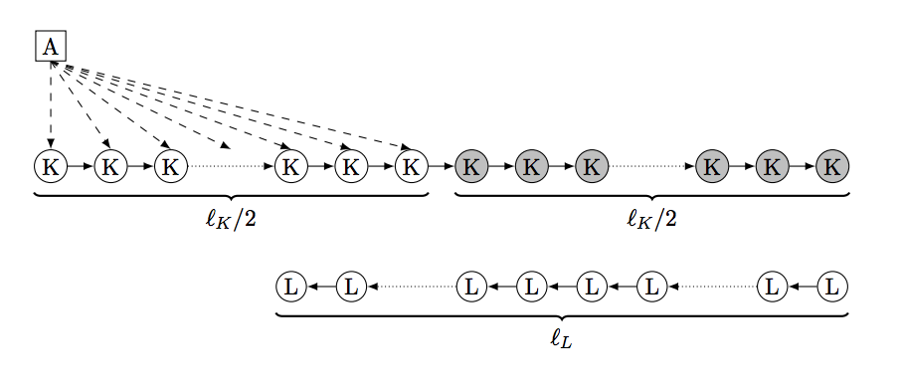
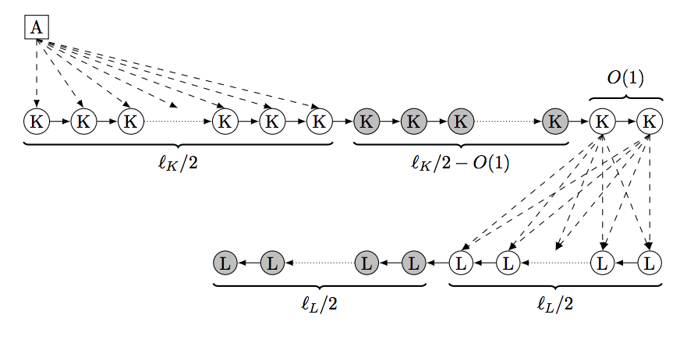
Intuition
For large enough λ (i.e., lots of sensitized patients), there exist pairs in D_{K} that can’t be matched in short cycles, thus only in chains
Same deal with D_{L}, except there are no chains
Connect a long chain (+altruist) in D_{K} into an unmatchable long chain in D_{L}, such that a linear number of D_{L} pairs are now matched

Slide 79
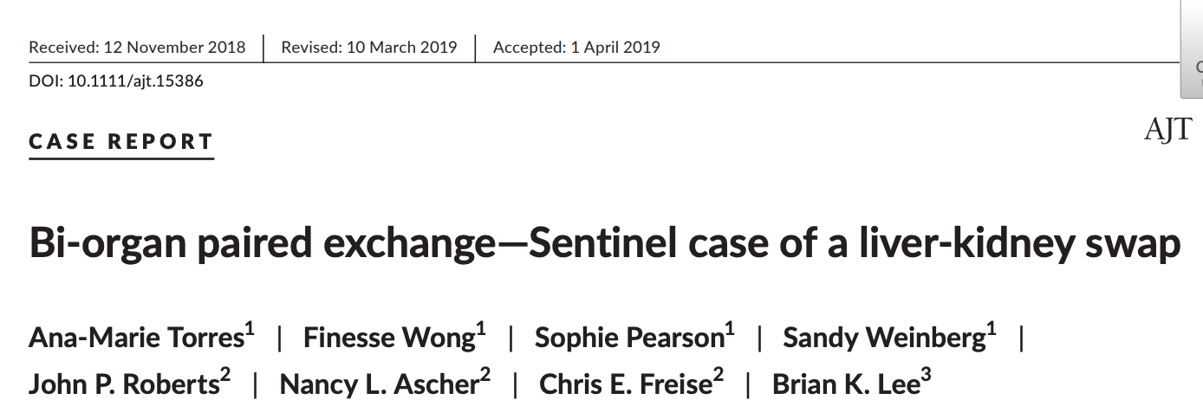
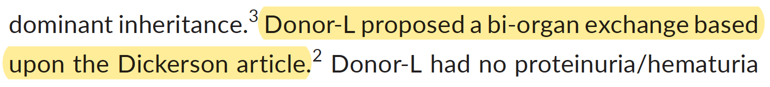
Ethical Issues Exist: But, this recently happened!
Patient-donor pairs are now exchanging different goods
600% incremental increase in mortality risk for liver vs. kidney donor
1/3000 risk of death for kidney donors [Muzaale et al. Gastroenterology 2012]
1/500 risk of death for liver donors [Cheah et al. Liver Transplantation 2013]

Slide 80
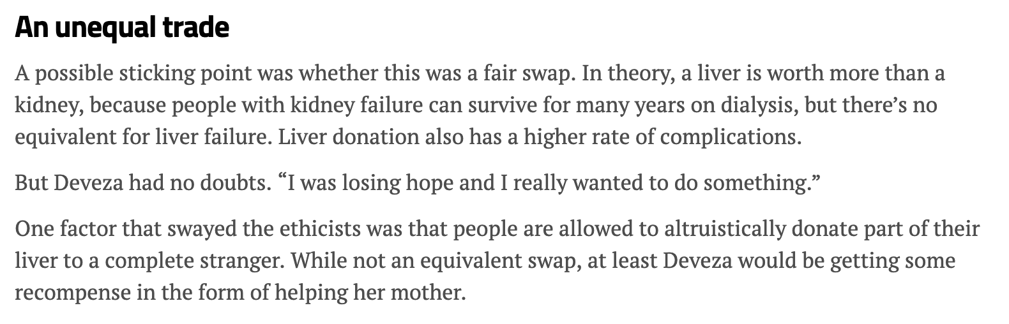
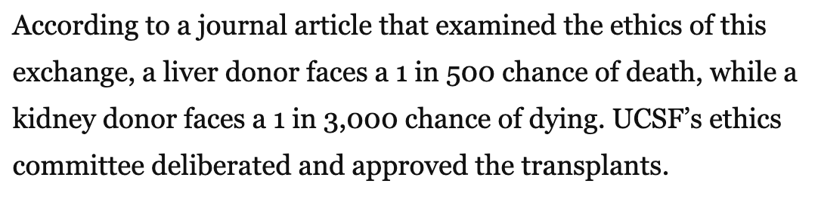
Real-world Reasoning about Ethics
A daughter’s gift to her mother saves two lives – The Washington Post – 11 May 2019
My liver, your kidney: The world's first non-identical organ swap – New Scientist – 9 May 2019

Slide 81
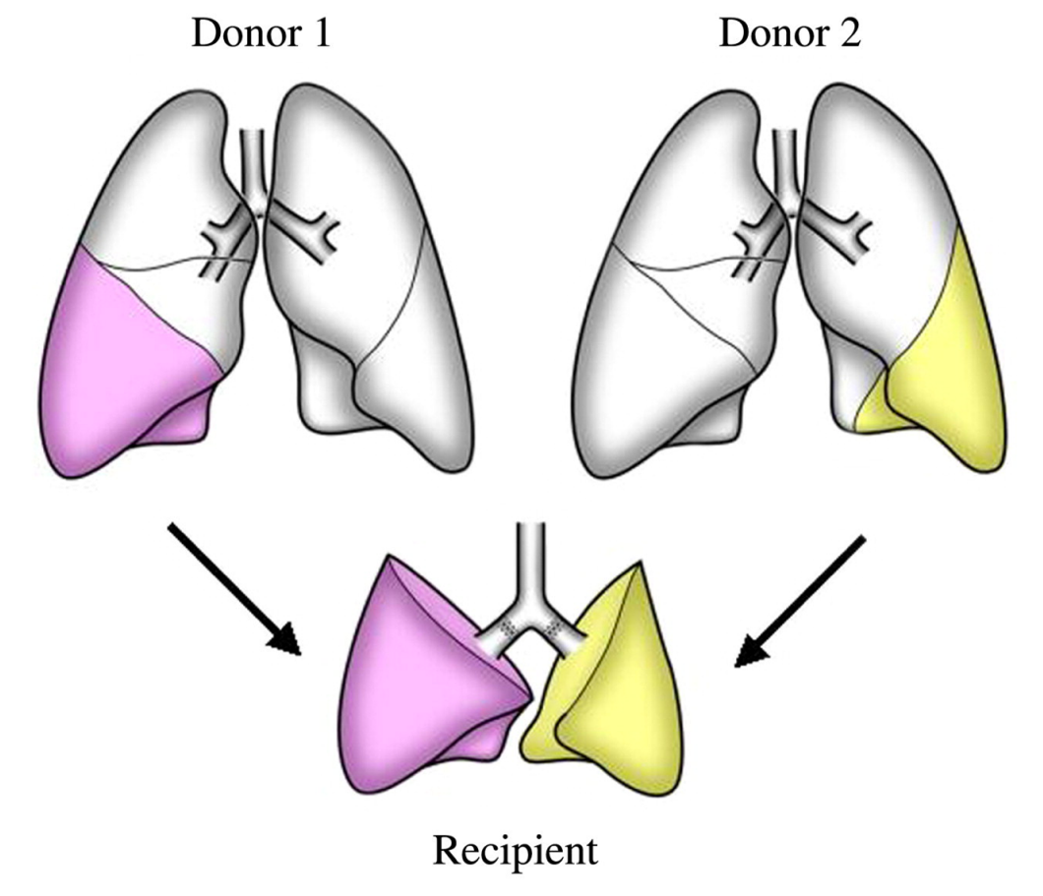
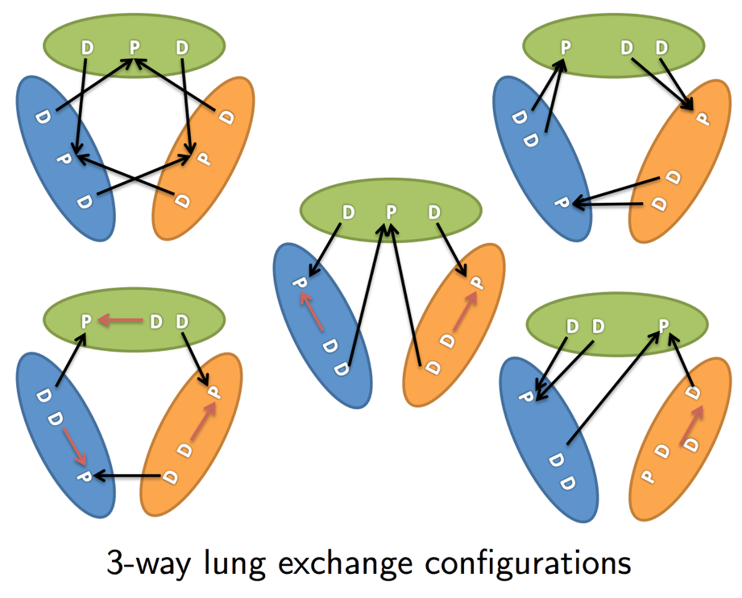
Moving beyond kidneys: Lungs
[Ergin, Sönmez, Ünver w.p. 2014]
Fundamentally different matching problem
Two donors needed
[Date et al. 2005; Sönmez 2014]
(Compare to the single configuration for a “3-cycle” in kidney exchange.)

Slide 82
Other Recent & Ongoing research in this space
Dynamic matching theory with a kidney exchange flavor:
Akbarpour et al., “Thickness and Information in Dynamic Matching Markets”
Anderson et al., “A dynamic model of barter exchange”
Ashlagi et al., “On matching and thickness in heterogeneous dynamic markets”
Das et al., “Competing dynamic matching markets”
Mechanism design:
Blum et al. “Opting in to optimal matchings”
Not “in the large” random graph models:
Ding et al., “A non-asymptotic approach to analyzing kidney exchange graphs

Slide 83
Is Life Always so (NP-)Hard?

Slide 84
One Simple Assumption Complexity Theory Hates!
[Dickerson Kazachkov Procaccia Sandholm arxiv:1605.07728]
Observation: real graphs are constructed from a few thousand if statements
If the patient and donor have compatible blood types …
... and if they are compatible on 61 tissue type features ...
... and if their insurances match, and ages match, and ...
... then draw a directed edge; otherwise, don’t
Hypothesis: real graphs can be represented by a small constant number of bits per vertex – we’ll test later
THEOREM
Given a constant number of if statements and a constant cycle cap, the clearing problem is in polynomial time

Slide 85
A New model For kidney Exchange
[Dickerson et al. arxiv:1605.07728]
Graph G = (V, E) with patient-donor pair v_{i} in V with
Attribute vectors d_{i} and p_{i} such that the qth element of d_{i} (resp. p_{i}) takes on one of a fixed number of types
E.g., d_{i}^{q} or p_{i}^{q} takes a blood type in {O, A, B, AB}
Call Θ the set of all possible “types” of d and p
Then, given compatibility function f : Θ x Θ → {0,1} that uniquely determines if an edge between d_{i} and p_{j} exists
We can create any compatibility graph (for large enough vectors in D and P)
(Altruists are patient-donor pairs where the “patient” is compatible with all donors → chains are now cycles)

Slide 86
Clearing is now in polynomial time
THEOREM
Given constant L and |Θ|, the clearing problem is in polynomial time
Let f(θ,θ’) = 1 if there is a directed edge from a donor with type θ to a patient with type θ’
For all θ = ( <θ_{1,p},θ_{1,d}> …, <θ_{r,p},θ_{r,d}>) in Θ^{2r} let f_{C}(θ) = 1 if f(θ_{t,d},θ_{t+1,p}) = 1 and f(θ_{r,d},θ_{1,p}) = 1
Given cycle cap L, define T(L) = { θ in Θ^{2r} : r ≤ L and f_{C}(θ) = 1 }

Slide 87
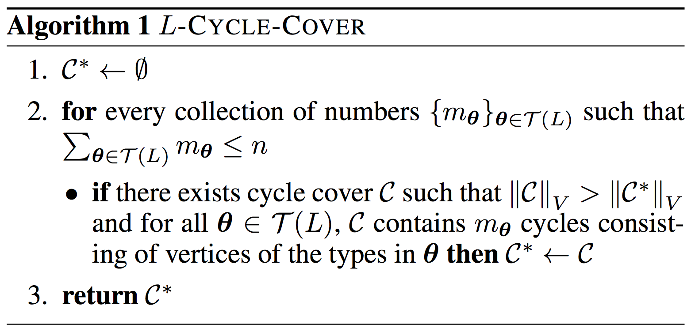
Clearing is now in polynomial time
T(L) is all vectors of types that create feasible cycles of length up to L

Slide 88
Clearing is now in polynomial time
Each set {m_{θ}} says we have m_{θ1} cycles of type θ₁, m_{θ2} cycles of θ₂, …, m_{θ|T(L)|} cycles of θ_{|T(L)|}, constrained to at most n cycles total

Slide 89
Clearing is now in polynomial time
Check to see if this collection is a legal cycle cover – just check that each type θ isn’t used too many times in m_{θ}

Slide 90
Clearing is now in polynomial time
Return the legal cycle cover such that the sum over θ of m_{θ} is maximized – aka the largest legal cycle cover

Slide 91
Flipping attributes is also easy
The human body tries to reject transplanted organs
Before transplantation, can immunnosupress some “bad” traits of the patient to increase transplant opportunity
Takes a toll on the patient’s health
Suppose we can pay some cost to change attributes
For all θ, θ’ in Θ, let c : Θ x Θ → R be cost of flipping θ → θ’
Flip-and-Cover: maximize match size minus cost of flips
THEOREM
Given constant L and |Θ|, the Flip-and-Cover problem is in polynomial time

Slide 92
A Concrete Instantiation: Thresholding
Associate with each patient and donor a k-bit vector
Count “conflict bits” that overlap at same position
If more than threshold t conflict bits, don’t draw an edge
Example: k = 2, blood containing antigens A and B
Θ = 2^{{ has-A, has-B }} x 2^{{ no-A, no-B }}
Draw edge if <d_{i}, p_{j}> ≤ t; do not draw edge otherwise
Donor type A = [ 1, 0 ]
Patient type AB = [ 0, 0 ]
Donor blood type
Patient blood type
Donor type A = [ 1, 0 ]
Patient type O = [ 1, 1 ]
AS IDE
Related to intersection graphs:
Each vertex has a set; draw edge between vertices iff sets intersect (by at least p elements)

Slide 93
Upper Bound: Sometimes You need Lots of bits
THEOREM
For any n > 2, there exists a graph on n vertices that is not (k,0)-representable for all k < n
For each vertex i, draw edge to each vertex except vertices i-1 and i
BWOC assume (k,0)-representable, k < n:
Consider vertex 1
(1, n) not in E; (1, i) in E otherwise
Then there is a conflict bit between vertex 1 and n that is not “turned on” anywhere else
Do for n vertices → require k ≥ n
1
2
6
3
5
4

Slide 94
Hardness: How many Bits do I Need For This Graph?
Given: an input graph G = (V, E) subset F of C(V, 2)
fixed positive k, nonnegative t
Does there exist:
k-length bit vectors d_{i}, p_{i} for all v_{i} in V
such that for (i,j) in F, also (i,j) in E iff <d_{i},p_{j}> ≤ t
THEOREM
The (k,t)-representation problem is NP-complete
(proof via reduction from 3SAT)

Slide 95
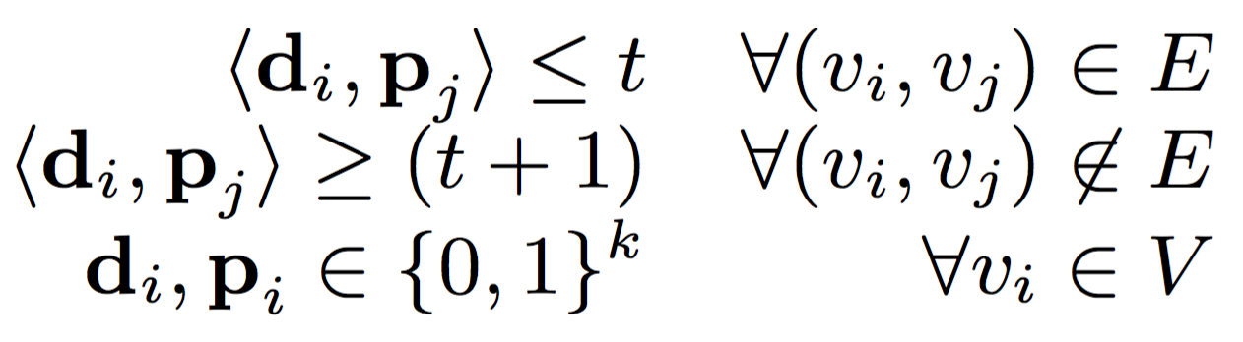
Computing (k,t)-Representations: QCP
For each vertex, give k bits to the patient and k bits to the donor
If an edge does not exist, make sure the overlap is greater than t
If an edge exists in the graph, assert the source donor vector and sink patient vector overlap by at most t
Quadratically-constrained discrete feasibility program:
Constraint matrix not positive semi-definite → non-convex
State-of-the-art nonlinear solvers (e.g., Bonmin) fail
[Bonami et al. 2008]

Slide 96
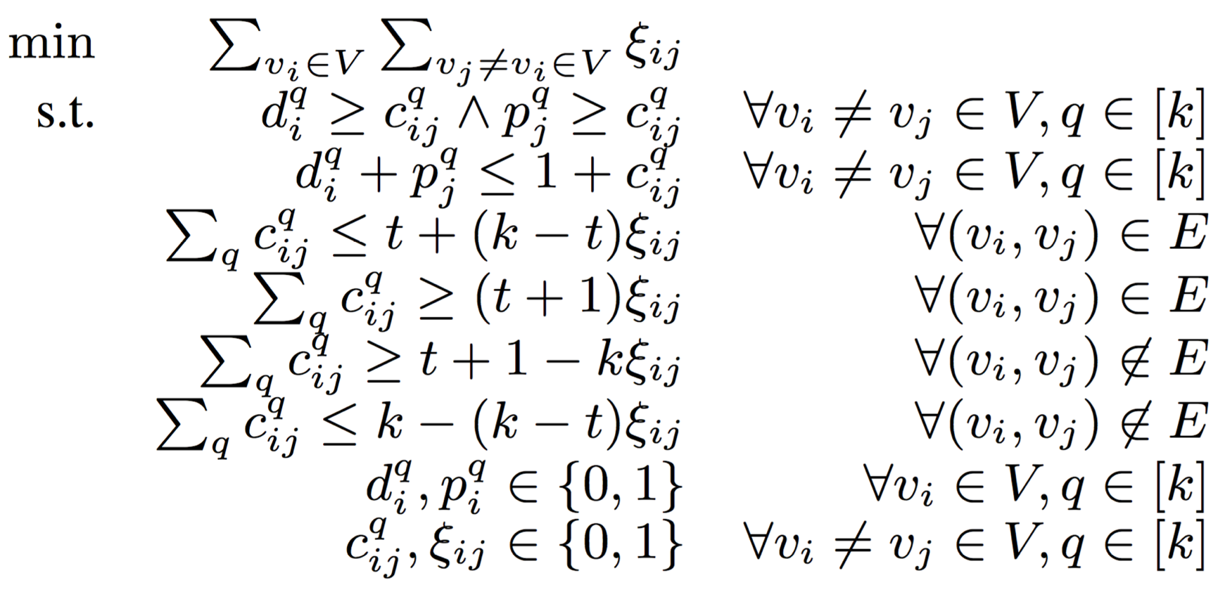
Computing (k,t)-Representations: IP
Integer program minimizes number of “conflict edges”
CPLEX struggles to find non-trivial solutions
CPLEX cannot find feasible solution (when forcing all ξ_{ij} = 0)

Slide 97
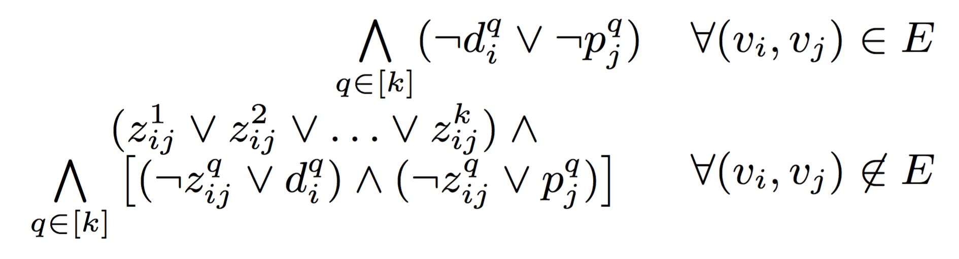
Computing (k,0)-Representations: SAT
Specific case of t = 0: if an edge does not exist, force any overlap
Specific case of t = 0: if an edge exists, allow no overlap
When t = 0, can use a compact SAT formulation
Interesting because it closely mimics real life
We can solve small- and medium-sized graphs
Use Lingeling, a good parallel SAT solver [Biere 2014]

Slide 98
Can we represent real graphs with a small number of bits?
Theory: k = |V|
Proved SAT
Unknown (?)
Proved UNSAT
Bigger real-world graphs (UNOS 2010 – 2012)

Slide 99
Relaxing the threshold
Everyone matched!*
(4-bit overlap allowed)
3x pairs matched!
(1-bit overlap allowed)
*all bits created equal, and not actually flipping bits – just relaxing global threshold
Loosen bit threshold t on real UNOS graphs

Slide 102
Backup slides
John P Dickerson

Slide 103
Failure-aware model
Compatibility graph G
Edge (v_{i}, v_{j}) if v_{i}’s donor can donate to v_{j}’s patient
Weight w_{e} on each edge e
Success probability q_{e} for each edge e
Discounted utility of cycle c
u(c) = ∑w_{e} • ∏q_{e}
Value of successful cycle
Probability of success

Slide 104
Failure-aware model
Discounted utility of a k-chain c
Cannot simply “reweight by failure probability”
Utility of a match M: u(M) = ∑ u(c)
Exactly first i transplants
Chain executes in entirety

Slide 105
Incrementally solving very large IPs
#Decision variables grows linearly with #cycles and #chains in the pool
Millions, billions of variables
Too large to fit in memory
Branch-and-price incrementally brings variables into a reduced model [Barnhart et al. 1998]
Solves the “pricing problem” – each variable gets a real-valued price
Positive price → resp. constraint in full model violated
No positive price cycles → optimality at this node

Slide 106
Considering only “good” chains
Theorem:
Given a chain c, any extension c’ will not be needed in an optimal solution if the infinite extension has non-positive value.
Optimistic future value of infinite extension
Donation to waitlist
Discounted utility of current chain
Pessimistic sum of LP dual values in model

Slide 107
G(n, t(n), p): random graph with
n patient-donor pairs
t(n) altruistic donors
Probability Θ(1/n) of incoming edges
Constant transplant success probability q
Theorem
For all q∈ (0,1) and α, β > 0, given a large G(n, αn, β/n), w.h.p. there exists some matching M’ s.t. for every maximum cardinality matching M,
u_{q}(M’) ≥ u_{q}(M) + Ω(n)

Slide 108
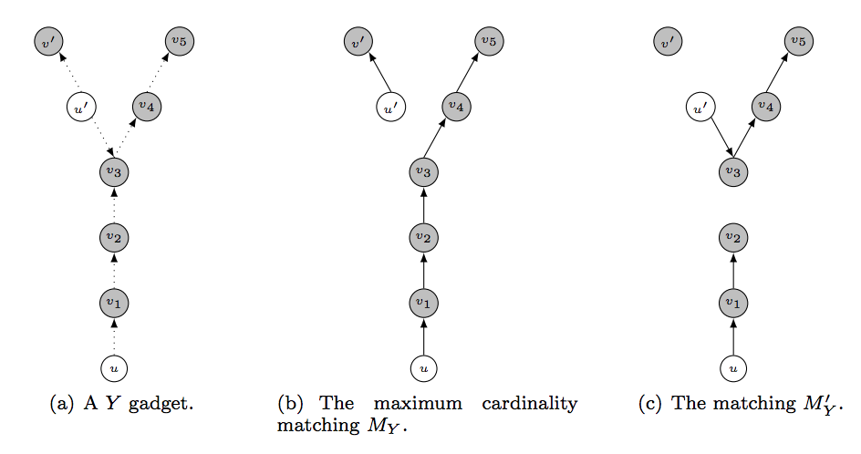
Brief intuition: Counting Y-gadgets
For every structure X of constant size, w.h.p. can find Ω(n) structures isomorphic to X and isolated from the rest of the graph
Label them (alt vs. pair): flip weighted coins, constant fraction are labeled correctly → constant × Ω(n) = Ω(n)
Direct the edges: flip 50/50 coins, constant fraction are entirely directed correctly → constant × Ω(n) = Ω(n)

Slide 109


Under the “most stringent” fairness rule:
Theorem
Assume “reasonable” level of sensitization and “reasonable” distribution of blood types. Then, almost surely as n → ∞,
(And this is achieved using cycles of length at most 3.)

Slide 110
Linear efficiency loss
Sublinear loss
Notes:
Under- and self-demanded pairs are white, over-demanded pairs are gray, and reciprocal pairs are black.
Regular edges appear in the efficient matching, while dashed edges represent 3-cycles from the efficient matching that may be disturbed via fair matching.

Slide 111
Better static optimization methods
Recall two main methods for solving big IPs for kidney exchange:
Branch-and-price = B&B + column generation
Constraint generation
Many different ways to do these:
E.g., how do I solve the pricing problem?
E.g., which constraints should I add to the model?
Big runtime changes [Anderson et al. PNAS-2015, Glorie et al. MSOM-2014]

Slide 112
Basic Edge formulation
[Abraham et al. 07]
Binary variable x_{ij} for each edge from i to j
Maximize
u(M) = Σ w_{ij} x_{ij}
Subject to
Σ_{j} x_{ij} = Σ_{j} x_{ji} for each vertex i
Σ_{j} x_{ij} ≤ 1 for each vertex i
Σ_{1≤k≤L} x_{i(k)i(k+1)} ≤ L-1 for paths i(1)…i(L+1)
(no path of length L that doesn’t end where it started – cycle cap)
Flow constraint

Slide 113
State of the art for edge formulation
[Anderson et al. PNAS-2015]
Builds on the prize-collecting traveling salesperson problem [Balas Networks-89]
PC-TSP: visit each city (patient-donor pair) exactly once, but with the additional option to pay some penalty to skip a city (penalized for leaving pairs unmatched)
They maintain decision variables for all cycles of length at most L, but build chains in the final solution from decision variables associated with individual edges
Then, an exponential number of constraints could be required to prevent the solver from including chains of length greater than K; these are generated incrementally until optimality is proved.
Leverage cut generation from PC-TSP literature to provide stronger (i.e. tighter) IP formulation

Slide 114
Best Edge Formulation
[Anderson et al. 15]
A
Ck
C3
If: flow into v from a chain
Then: at least as much flow across cuts from {A}
A
C1
V
A
C2
…
Notes:
If there is flow into V, then for every way V can be cut off from NDDs, there must be at least as much flow over that cut.

Slide 115
Review: Cycle formulation
Objective = maximum cardinality
Binary variable x_{c} for each cycle/chain c of length at most L
Maximize
Σ |c|x_{c}
Subject to
Σ_{c : i in c} x_{c} ≤ 1 for each vertex i

Slide 116
DFS to solve pricing problem
[Abraham et al. PNAS-2015]
Pricing problem:
Optimal dual solution π* to reduced model
Find non-basic variables with positive price (for a maximization problem)
0 < weight of cycle – sum of duals in π* of constituent vertices
First approach [Abraham et al. EC-2007] explicitly prices all feasible cycles and chains through a DFS
Can speed this up in various ways, but proving no positive price cycles exist still takes time poly in chain/cycle cap = bad for even reasonable caps

Slide 117
The Right Idea
Idea: solve structured optimization problem that implicitly prices variables
Price: w_{c} – Σ_{v in c} δ_{v} = Σ_{e in c} w_{e} – Σ_{v in c} δ_{v} = Σ_{(u,v) in c} [w_{(u,v)} – δ_{v}]
Take G, create G’ s.t. all edges e = (u,v) are reweighted r_{(u,v)} = δ_{v} – w_{(u,v)}
Positive price cycles in G = negative weight cycles in G’
Bellman-Ford finds shortest paths
Undefined in graphs with negative weight
Adapt B-F to prevent internal looping during the traversal
Shortest path is NP-hard (reduce from Hamiltonian path:
Set edge weights to -1, given edge (u,v) in E, ask if shortest path from u to v is weight 1-|V| → visits each vertex exactly once
We only need some short path (or proof that no negative cycle exists)
Now pricing runs in time O(|V||E|cap²)

Slide 118
Loop Blocking Must Be During Traversal
P5
0
A
0
P1
0
P2
0
-1
-2
0
P6
0
P7
0
P8
P4
P3
0
(cycle cap = 3, chain cap = 6)

Slide 119
Experimental results
Note: Anderson et al.’s algorithm (CG-TSP) is very strong for uncapped aka “infinite-length” chains, but a chain cap is often imposed in practice

